Slide 1
Module 5
Coordination
Time and Global States – Coordination and Agreement – Transaction and Concurrency Control- Distributed Transactions

Slide 2
Introduction
Importance of time in distributed systems
– A quantity to timestamp events accurately
• To know what time a particular event occurs
• i.e. Recording when an e-commerce transaction occurs
– A synchronization source for several distributed algorithms
• To maintain consistency of distributed data
• i.e. Eliminating duplicate updates
– A timing source for multiple events
• To provide relative order of two events
• i.e. Ensuring the order of cause and effect
• Clocks in computers to establish
– Time at which an event occurred
– Duration of an event or interval between two events
– Sequence of a series of events or the order in which events occurred

Slide 3
Clocks, Events and Process States
A distributed system consists of a collection P of N processes pi, i = 1,2,… N
– Each process pi has a state si consisting of its variables
(which it transforms as it executes)
– Processes communicate only by messages (via a network)
• Actions of processes: Send, Receive, change own state
Event: the occurrence of a single action that a process carries out as it executes
• Events at a single process pi, can be placed in a total ordering
denoted by the relation →i between the events. i.e.
– e →i e’ if and only if event e occurs before event e’ at process pi
• A history of process pi: is a series of events ordered by →i
–

Slide 4
Clocks
To timestamp events, use the computer’s clock
At real time, t, the OS reads the time on the computer’s hardware clock
It calculates the time on its software clock
Ci(t)=αHi(t) + β
e.g. a 64 bit value giving nanoseconds since some base time
Clock resolution: period between updates of the clock value
In general, the clock is not completely accurate
but if Ci behaves well enough, it can be used to timestamp events at pi

Slide 5
Skew between computer clocks in a distributed system
Computer clocks are not generally in perfect agreement
• Clock skew: the difference between the times on two clocks (at any instant)
• Computer clocks use crystal-based clocks that are subject to physical
variations
– Clock drift: they count time at different rates and so diverge (frequencies of oscillation differ)
– Clock drift rate: the difference per unit of time from some ideal reference clock
– Ordinary quartz clocks drift by about 1 sec in 11-12 days. (10-6 secs/sec).
– High precision quartz clocks drift rate is about 10-7 or 10-8 secs/sec

Slide 6
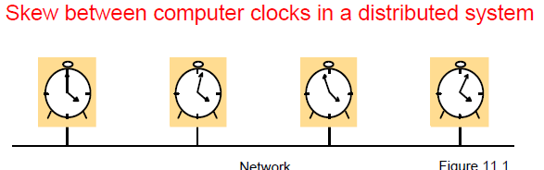

Slide 7
Coordinated Universal Time (UTC)
UTC is an international standard for time keeping
– It is based on atomic time, but occasionally adjusted to astronomical time
– International Atomic Time is based on very accurate physical clocks (drift rate 10⁻¹³)
It is broadcast from radio stations on land and satellite (e.g.GPS)
Computers with receivers can synchronize their clocks with these timing signals (by requesting time from GPS/UTC source)
– Signals from land-based stations are accurate to about 0.1-10 millisecond
– Signals from GPS are accurate to about 1 microsecond

Slide 8
Synchronizing physical clocks
Two models of synchronization
Internal – The clocks in the set must agree within a bound d
External – The clocks must be accurate respect to a source of UTC time within a bound d
– Setting the time back is never allowed ⇒ smooth adjustments
External synchronization: a computer’s clock C_{i} is synchronized with an external authoritative time source S, so that:
– |S(t) - C_{i}(t)| < D for i = 1, 2, …N over an interval, I of real time
– The clocks C_{i} are accurate to within the bound D.
Cristian’s method - pulling server
Every machine asks a time server for the accurate time at least once every d/(2r) seconds

Slide 9
Synchronizing physical clocks
Internal synchronization: the clocks of a pair of computers are synchronized with one another so that:
– |C_{i}(t) - C_{j}(t)| < D for i = 1, 2, … N over an interval, I of real time
– The clocks Ci and Cj agree within the bound D.
Internally synchronized clocks are not necessarily externally synchronized, as they may drift collectively
– if the set of processes P is synchronized externally within a bound D, it is also internally synchronized within bound 2D (worst case polarity)
Pushing server – Berkeley algorithm
Let the time server scan all machines periodically, calculate an avg (accounting for rtt), and inform each machine how to adjust its time

Slide 10
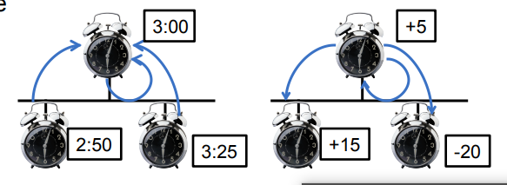

Slide 11
Clock correctness
Correct clock: a hardware clock H is said to be correct if its drift rate is within a bound ρ > 0 (e.g. 10⁻⁶ secs/ sec)
This means that the error in measuring the interval between real times t and t’ is bounded:
– (1 - ρ ) (t’ - t) ≤ H(t’) - H(t) ≤ (1 + ρ ) (t’ - t) (where t’>t)
– Which forbids jumps in time readings of hardware clocks
• Clock monotonicity: weaker condition of correctness
– t' > t ⇒ C(t’) > C(t)
– e.g. required by Unix make
– A hardware clock that runs fast can achieve monotonicity by adjusting the values of α and β such that C_{i}(t)= αH_{i}(t) + β
• Faulty clock: a clock not keeping its correctness condition
– crash failure - a clock stops ticking
– arbitrary failure - any other failure
• e.g. jumps in time; Y2K bug

Slide 12
A historical example of an arbitrary failure is that of a clock with the ‘Y2K bug’, which broke the monotonicity condition by registering the date after 31 December 1999 as 1 January 1900 instead of 2000; another example is a clock whose batteries are very low and whose drift rate suddenly becomes very large.

Slide 13
Synchronization in a synchronous system
A synchronous distributed system is one in which the following
bounds are defined:
– the time to execute each step of a process has known lower and upper bounds
– each message transmitted over a channel is received within a known
bounded time (min and max)
– each process has a local clock whose drift rate from real time has a known bound

Slide 14
required to execute each step of a process (see Section 2.4.1).
One process sends the time t on its local clock to the other in a message m. In principle, the receiving process could set its clock to the time t + Ttrans , where Ttrans is the time taken to transmit m between them.
Ttrans is subject to variation and is unknown
Nonetheless, there is always a minimum transmission time, min
In a synchronous system, by definition, there is also an upper bound max on the time taken to transmit any message. Let the uncertainty in the message transmission time be u, so that u = max – min . If the receiver sets its clock to be t + min , then the clock skew may be as much as u, since the message may in fact have taken time max to arrive.

Slide 15
NTP - The Network Time Protocol
Cristian’s method and the Berkeley algorithm are intended primarily for use within intranets.
The Network Time Protocol (NTP) [Mills 1995] defines an architecture for a time service and a protocol to distribute time information over the Internet.
NTP’s chief design aims and features are as follows:
To provide a service enabling clients across the Internet to be synchronized accurately to UTC:
Although large and variable message delays are encountered in Internet communication, NTP employs statistical techniques for the filtering of timing data and it discriminates between the quality of timing data from differentserver

Slide 16
To provide a reliable service that can survive lengthy losses of connectivity: There are redundant servers and redundant paths between the servers. The servers can reconfigure so as to continue to provide the service if one of them becomes unreachable.
To enable clients to resynchronize sufficiently frequently to offset the rates of drift found in most computers: The service is designed to scale to large numbers of clients and servers.
To provide protection against interference with the time service, whether malicious or accidental: The time service uses authentication techniques to check that timing data originate from the claimed trusted sources. It also validates the return addresses of message send to it.

Slide 17
The NTP service is provided by a network of servers located across the Internet.
Primary servers are connected directly to a time source such as a radio clock receiving UTC;
secondary servers are synchronized, ultimately, with primary servers.
The servers are connected in a logical hierarchy called a synchronization subnet whose levels are called strata.
Primary servers occupy stratum 1: they are at the root.
Stratum 2 servers are secondary servers that are synchronized directly with the primary servers;
stratum 3 servers are synchronized with stratum 2 servers, and so on. The lowest-level (leaf) servers execute in users’ workstations.

Slide 18
The clocks belonging to servers with high stratum numbers are liable to be less accurate than those with low stratum numbers, because errors are introduced at each level of synchronization.
NTP also takes into account the total message round-trip delays to the root in assessing the quality of timekeeping data held by a particular server.
The synchronization subnet can reconfigure as servers become unreachable or failures occur. If, for example, a primary server’s UTC source fails, then it can become a stratum 2 secondary server.
If a secondary server’s normal source of synchronization fails or becomes unreachable, then it may synchronize with another server.

Slide 19
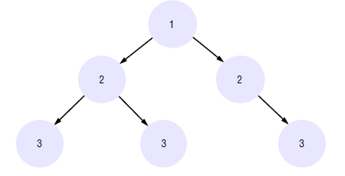
Arrows denote synchronization control, numbers denote strata.

Slide 20
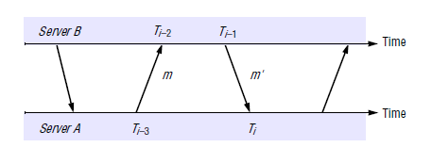
NTP servers synchronize with one another in one of three modes: multicast, procedure-call and symmetric mode.
Multicast mode
Procedure-call mode is similar to the operation of Cristian’s algorithm,
Finally, symmetric mode achieves high accuracy
In all modes, messages are delivered unreliably, using the standard UDP Internet transport protocol

Slide 21
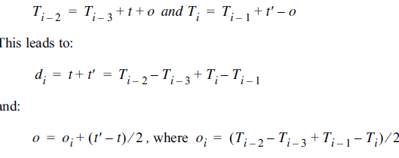

Slide 22
NTP servers apply a data filtering algorithm to successive pairs <oi. di>, which estimates the offset o and calculates the quality of this estimate as a statistical quantity called the filter dispersion.
A relatively high filter dispersion represents relatively unreliable data.
In general, an NTP server engages in message exchanges with several of its peers.
In addition to data filtering applied to exchanges with each single peer, NTP applies a peer-selection algorithm.
This examines the values obtained from exchanges with each of several peers, looking for relatively unreliable values.
The output from this algorithm may cause a server to change the peer that it primarily uses for synchronization.
Peers with lower stratum numbers are more favoured than those in higher strata because they are ‘closer’ to the primary time sources.

Slide 23
NTP employs a phase lock loop model [Mills 1995], which modifies the local clock’s update frequency in accordance with observations of its drift rate

Slide 24
Logical time and logical clock
From the point of view of any single process, events are ordered uniquely by times shown on the local clock. However, as Lamport [1978] pointed out, since we cannot synchronize clocks perfectly across a distributed system, we cannot in general use physical time to find out the order of any arbitrary pair of events occurring within it.
In general, we can use a scheme that is similar to physical causality but that applies in distributed systems to order some of the events that occur at different processes. This ordering is based on two simple and intuitively obvious points:
Eg I enter the house only after I unlock it
U receive a letter only after I send it

Slide 25
If two events occurred at the same process p_{i}=(i = 1,2, ..N) , then they occurred in the order in which p_{i} observes them – this is the order ->i that we defined above.
• Whenever a message is sent between processes, the event of sending the message occurred before the event of receiving the message.
Lamport called the partial ordering obtained by generalizing these two relationships the happened-before relation.
It is also sometimes known as the relation of causal ordering or potential causal ordering.
happened-before relation, denoted by →, as follows

Slide 26
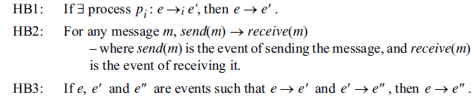

Slide 27
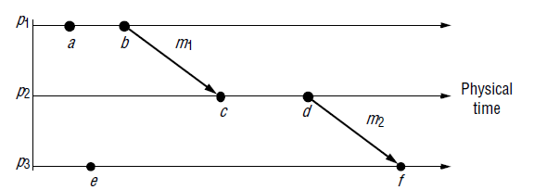

Slide 28
‘a’ and ‘e’ are not related by → since no relation, but they are concurrent represented by a || e

Slide 29
In practice Lamport timestamps
Logical clocks • Lamport [1978] invented a simple mechanism by which the happened before ordering can be captured numerically, called a logical clock. A Lamport logical clock is a monotonically increasing software counter, whose value need bear no particular relationship to any physical clock.
Each process p_{i} keeps its own logical clock, L_{i} , which it uses to apply so-called Lamport timestamps to events.
We denote the timestamp of event e at p_{i} by L_{i} € , and by L(e) we denote the timestamp of event e at whatever process it occurred at.

Slide 30
Rule
Each process used a local counter (clock) which is an integer initialised to 0
A process increments its counter value when a send or an instruction happen at it. The counter is assigned to the event at its time stamps.
A send message carries a time stamps
For a receive (message) event the counter is updated by
max(local clock, message timestamp)+1

Slide 31
LC1: L_{i} is incremented before each event is issued at process p_{i} :
L_{i} := L_{i} + 1.
LC2: (a) When a process p_{i} sends a message m, it piggybacks on m the value t = L_{i} .
(b) On receiving (m, t), a process p_{j} computes L_{j} := max(L_{f} , t) and then applies LC1 before timestamping the event receive(m).
e→e’ => L(e) < L(e’) converse is not true
If L(e) < L(e’) then we cannot say e->e’

Slide 32
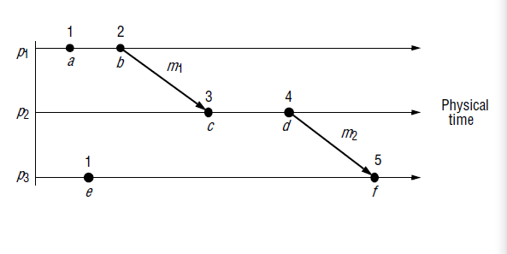

Slide 33
e→e’ => L(e) < L(e’) converse is not true
If L(e) < L(e’) then we cannot infer that e->e’
Each of the processes p1 , p2 and p3 has its logical clock initialized to 0. The clock values given are those immediately after the event to which they are adjacent.
Note that, for example L(b) > L(e) but b||e

Slide 34
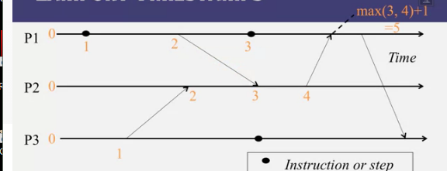

Slide 35
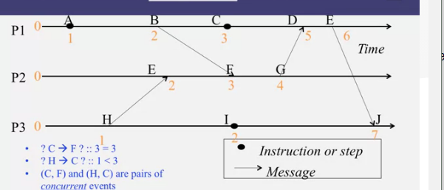

Slide 36
Totally ordered logical clocks
Some pairs of distinct events, generated by different processes, have numerically identical Lamport timestamps. However, we can create a total order on the set of events – that is, one for which all pairs of distinct events are ordered – by taking into account the identifiers of the processes
If e is an event occurring at p_{i} with local timestamp T_{i} , and e’ is an event occurring at p_{j} with local timestamp T_{j} , we define the global logical timestamps for these events to
be (T_{i}, i) and (T_{j}, j), respectively. And we define (T_{i}, i) < (T_{j}, j), if and only if either T_{i} < T_{j} , or T_{i} = T_{j} and i< j . This ordering has no general physical significance (because process identifiers are arbitrary), but it is sometimes useful. Lamport used it,
for example, to order the entry of processes to a critical section. s at which events occur.

Slide 37
Vector Clocks
Mattern [1989] and Fidge [1991] developed vector clocks to overcome the shortcoming of Lamport’s clocks: the fact that from L(e) < L (e’) we cannot conclude that e→e’
· A vector clock for a system of N processes is an array of N integers. Each process keeps its own vector clock, V_{i} , which it uses to timestamp local events. Like Lamport timestamps, processes piggyback vector timestamps on the messages they send to one another, and there are simple rules for updating the clocks:

Slide 38
VC1: Initially, V_{i}[j] = 0 , for I, j = 1,2,…N .
VC2: Just before p_{i} timestamps an event, it sets
V_{i}[i] :=V_{i}[i]+1.
VC3: p_{i} includes the value t = V_{i} in every message it sends.
VC4: When p_{i} receives a timestamp t in a message, it sets
V_{i}[j] := max(Vi[j],t[j]) for j = 1, 2,…N . Taking the componentwise maximum of two vector timestamps in this way is known as a merge operation.

Slide 39
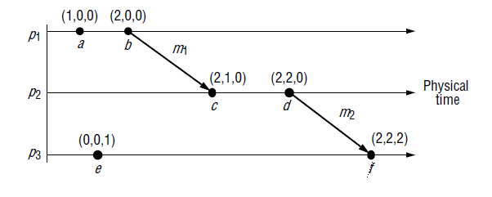

Slide 40
It can be seen, for example, that V(a) <V(f), which reflects the fact that a->f.
Similarly, we can tell two events are concurrent by comparing their timestamps.
For example, that c || e can be seen from the facts that
neither V(c) ≤ V(e) nor V(e) ≤ V(c)

Slide 41
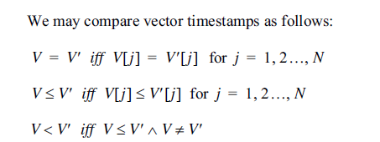

Slide 42
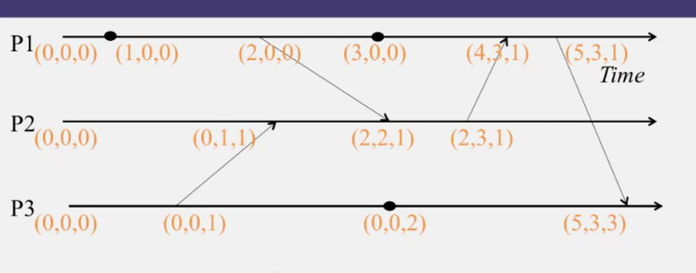

Slide 43
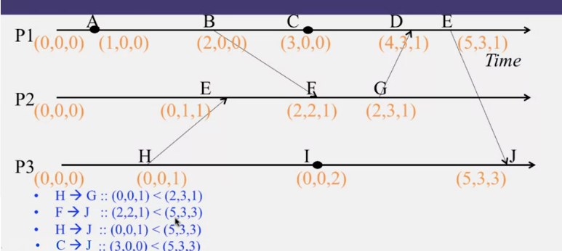

Slide 44
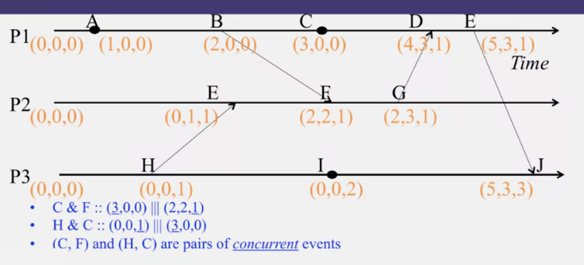

Slide 45
summary
Lambport timestamps
Integer clocks assigned to events
Obeys causality
Cannot distinguish concurrent events
Vector timestamps
Obey causality
Concurrent events can also be identified

Slide 46
Global states
Use logical time to construct a global view of the system state and determine whether a particular property is true
Examples
Distributed garbage collection
Distributed deadlock detection
Distributed termination detection
Distributed termination detection
In general, this problem is referred to as Global Predicate Evaluation

Slide 47
Global Predicate Evaluation
Global state predicate is a function that maps from the set of global state of processes in the system ρ to {True, False}
Two requirements
Safety - a predicate always evaluates to false. A given undesirable property (e.g., deadlock) never occurs.
Liveness - a predicate eventually evaluates to true. A given desirable property (e.g., termination) eventually occurs.

Slide 48
How to get global state of the system?
With lack of global clock, getting global state at a particular time is not possible
Use Cuts
Cuts provide the ability to "assemble a meaningful global state from local states recorded at different times"

Slide 49
Definitions
ρ is a system of N processes p_{i} (i = 1, 2, ..., N)
history(p_{i}) = h_{i} = < e i 0 , e i 1 ,...>
- a finite prefix of the process's history

Slide 50
Cuts
Cut = time frontier at each process and at each channel
Events at the process/channel that happened before the cut are “in the cut”
And the happening after the cut are “out of the cut”
Strongly Consistent cut - (B->E)
Consistent Cut - (H->F)
Inconsistent cut - (G->D)
Consistent Cut: the cut that obeys causality :
A cut C is a consistent cut iff
for (each pair of events e, f in the system)
Such that event e is in the cut if f->e (f happens before e)
Then event f is also in the cut C

Slide 51
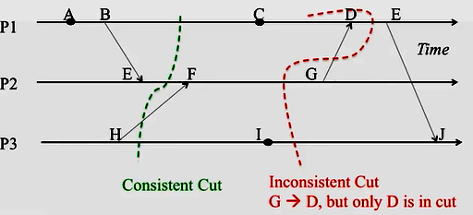

Slide 52
consistent global state
Run
linearization or consistent run
Global state predicates
Stability, safety and liveness

Slide 53
Global Snapshot

Slide 54
Why do we need snapshots?
• Checkpointing: restart if the application fails
• Collecting garbage: remove objects that don’t
have any references
• Detecting deadlocks: can examine the current
application state
• Other debugging: a little easier to work with

Slide 55
System model
The system consists of a collection of n processes p1,p2, ...,pn that are connected by channels.
There are no globally shared memory and physical global clock and processes communicate by passing messages through communication channels
Cij denotes the channel from process pi to process pj and its state is denoted by SCij.
The actions performed by a process are modeled as three types of events :Internal events, the message send event and the message receive event.
For a message mij that is sent by process pi to process pj, let send(mij) and rec(mij) denote its send and receive events.

Slide 56
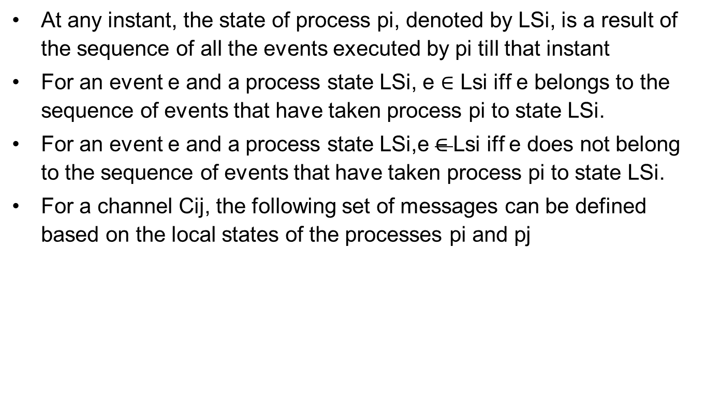
Continued…
At any instant, the state of process pi, denoted by LSi, is a result of the sequence of all the events executed by pi till that instant
For an event e and a process state LSi, e ∈ Lsi iff e belongs to the sequence of events that have taken process pi to state LSi.
For an event e and a process state LSi,e $∈$Lsi iff e does not belong to the sequence of events that have taken process pi to state LSi.
For a channel Cij, the following set of messages can be defined based on the local states of the processes pi and pj

Slide 57


Global State
A global state GS is a consistent global state iff it satisfies the following two
conditions :

Slide 58
Issues in recording a global state
How to distinguish between the messages to be recorded in the snapshot from those not to be recorded.
Any message that is sent by a process before recording its snapshot, must be recorded in the global snapshot (C1)
Any message that is sent by a process after recording its snapshot, must not be recorded in the global snapshot (C2)
How to determine the instant when a process takes its snapshot.
A process pj must record its snapshot before processing a message mij that was sent by process pi after recording its snapshot.

Slide 59
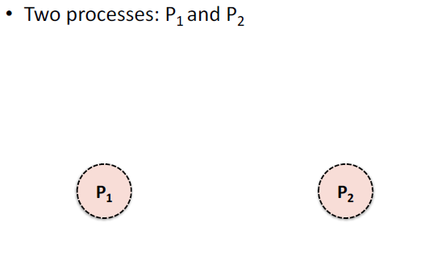

Slide 60
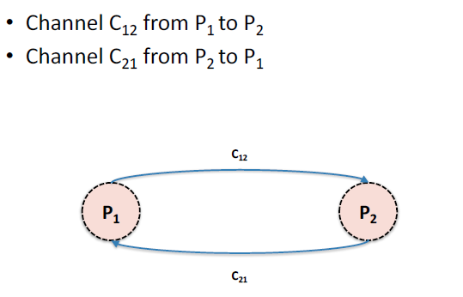

Slide 61
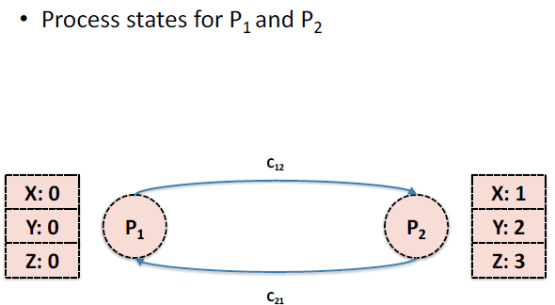

Slide 62
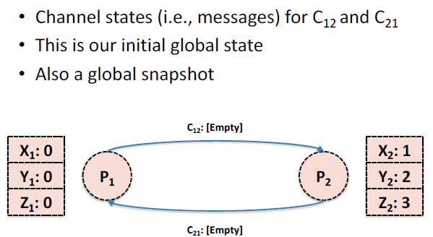

Slide 63
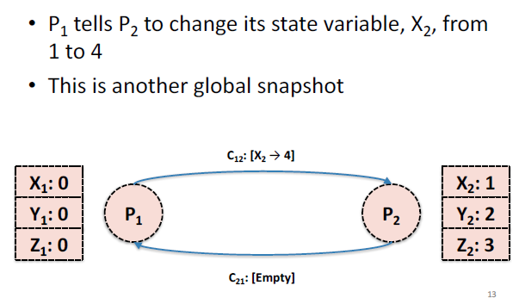

Slide 64
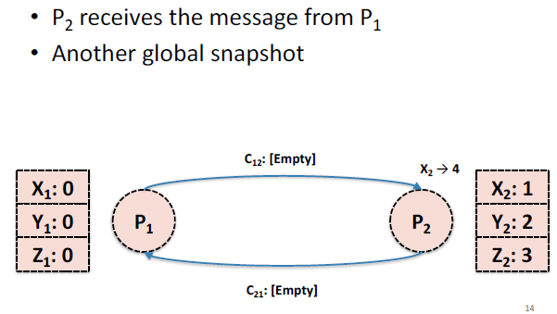

Slide 65
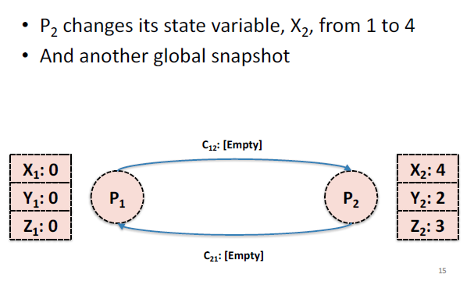

Slide 66
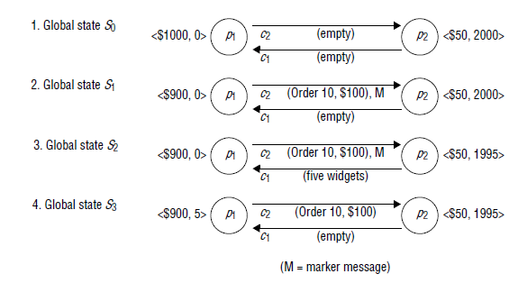

Slide 67
Snapshot algorithms for FIFO channels
The Chandy-Lamport algorithm uses a control message, called a marker whose role in a FIFO system is to separate messages in the channels.
After a site has recorded its snapshot, it sends a marker, along all of its outgoing channels before sending out any more messages.
A marker separates the messages in the channel into those to be included in the snapshot from those not to be recorded in the snapshot.
A process must record its snapshot no later than when it receives a marker on any of its incoming channels.

Slide 68
Chandy-Lamport algorithm
System model
• Problem: record a global snapshot (state for
each process and channel)
• Model
– N processes in the system with no failures
– There are two FIFO unidirectional channels
between every process pair (Pi → Pj and Pj → Pi)
– All messages arrive, intact, not duplicated

Slide 69
System requirements
• Taking a snapshot shouldn’t interfere with
normal application behavior
– Don’t stop sending messages
– Don’t stop the application!
• Each process can record its own state
• Collect state in a distributed manner
• Any process can initiate a snapshot

Slide 70
Initiating a snapshot
• Let’s say process Pi initiates the snapshot
• Pi records its own state and prepares a special
marker message (distinct from application
messages)
• Send the marker message to all other
processes (using N-1 outbound channels)
• Start recording all incoming messages from
channels Cji for j not equal to i

Slide 71
Propagating a snapshot
• For all processes Pj (including the initiator),
consider a message on channel Ckj
• If we see marker message for the first time
– Pj records own state and marks Ckj as empty
– Send the marker message to all other processes
(using N-1 outbound channels)
– Start recording all incoming messages from
channels Clj for l not equal to j or k
• Else
add all messages from inbound channels since we began recording their states

Slide 72
Terminating a snapshot
• All processes have received a marker (and
recorded their own state)
• All processes have received a marker on all the
N-1 incoming channels (and recorded their
states)
• Later, a central server can gather the partial
state to build a global snapshot

Slide 73
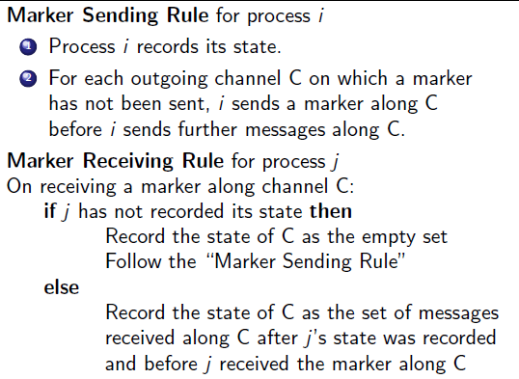
Chandy – Lamport Algorithm -- In a Nut Shell

Slide 74
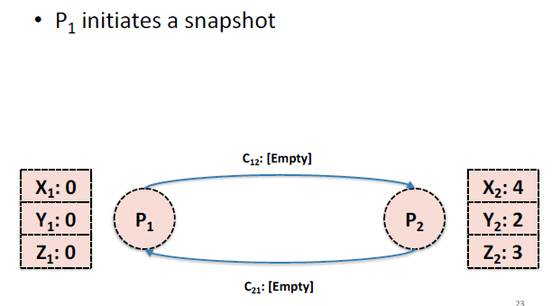

Slide 75
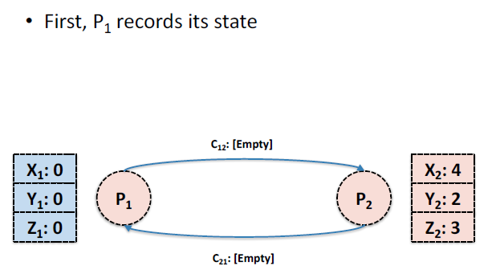

Slide 76
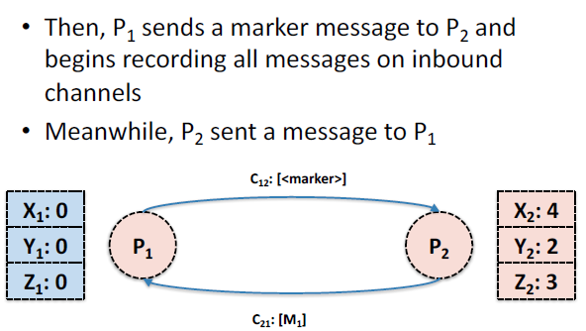

Slide 77
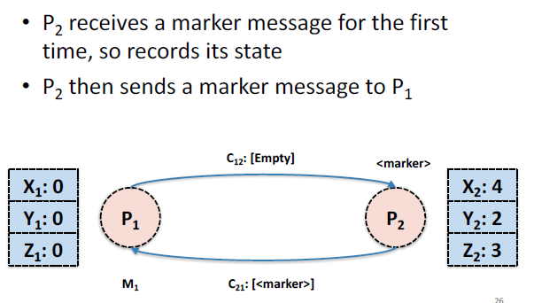

Slide 78
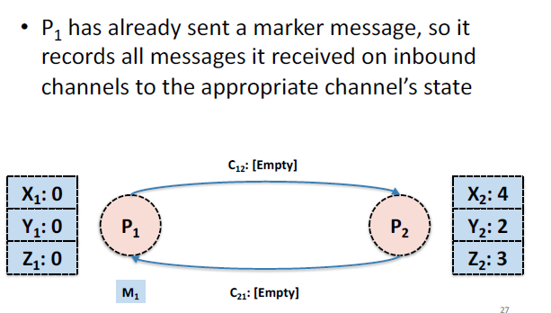

Slide 79
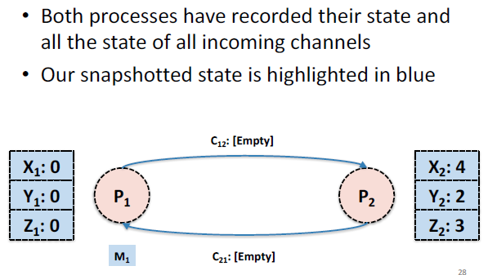

Slide 80
Another Example
A B C D E
P1
Time
E F G
P2
H I J
P3
Instruction or Step
Message

Slide 81
P1 is Initiator:
Record local state S1,
Send out markers
Turn on recording on channels C₂₁, C₃₁
A B C D E
P1
Time
E F G
P2
H I J
P3

Slide 82
S1, Record C₂₁, C₃₁
A B C D E
P1
Time
E F G
P2
H I J
P3
First Marker!
Record own state as S3
Mark C₁₃ state as empty
Turn on recording on other incoming C₂₃
Send out Markers

Slide 83
S1, Record C₂₁, C₃₁
A B C D E
P1
Time
E F G
P2
H I J
P3
S3
C₁₃ = < >
Record C₂₃

Slide 84
Duplicate Marker!
State of channel C₃₁ = < >
S1, Record C₂₁, C₃₁
A B C D E
P1
Time
E F G
P2
H I J
P3
S3
C₁₃ = < >
Record C₂₃

Slide 85
S1, Record C₂₁, C₃₁
C₃₁ = < >
A B C D E
P1
Time
E F G
P2
H I J
P3
First Marker!
Record own state as S2
Mark C₃₂ state as empty
Turn on recording on C₁₂
Send out Markers
S3
C₁₃ = < >
Record C₂₃

Slide 86
S1, Record C₂₁, C₃₁
C₃₁ = < >
A B C D E
P1
Time
E F G
P2
H I J
P3
S3
C₁₃ = < >
Record C₂₃
S2
C₃₂ = < >
Record C₁₂

Slide 87
S1, Record C₂₁, C₃₁
C₃₁ = < >
A B C D E
P1
Time
E F G
P2
H I J
P3
S3
C₁₃ = < >
Record C₂₃
S2
C₃₂ = < >
Record C₁₂
Duplicate!
C₁₂ = < >

Slide 88
Duplicate!
C₂₁ = <message G→D >
S1, Record C₂₁, C₃₁
C₃₁ = < >
A B C D E
P1
Time
E F G
P2
H I J
P3
S3
C₁₃ = < >
Record C₂₃
S2
C₃₂ = < >
Record C₁₂
C₁₂ = < >

Slide 89
C₂₁ = <message G→D >
S1, Record C₂₁, C₃₁
C₃₁ = < >
A B C D E
P1
Time
E F G
P2
H I J
P3
S3
C₁₃ = < >
Record C₂₃
S2
C₃₂ = < >
Record C₁₂
C₁₂ = < >
Duplicate!
C₂₃ = < >

Slide 90
Algorithm has terminated
C₂₁ = <message G→D >
S1
C₃₁ = < >
A B C D E
P1
Time
E F G
P2
H I J
P3
S3
C₁₃ = < >
S2
C₃₂ = < >
C₁₂ = < >
C₂₃ = < >

Slide 91
Collect the global snapshot pieces
C₂₁ = <message G→D >
S1
C₃₁ = < >
A B C D E
P1
Time
E F G
P2
H I J
P3
S2 C₃₂ = < >
C₁₂ = < >
S3 C₁₃ = < >
C₂₃ = < >

Slide 92
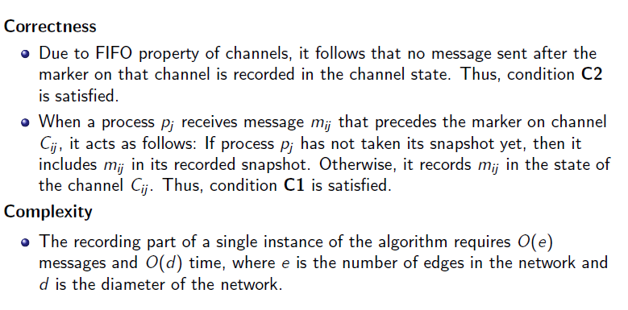
Correctness and Complexity

Slide 93
Coordination and Agreement
• Fundamental issue: for a set of processes, how to coordinate their actions or to agree on one or more values?
– even no fixed master-slave relationship between the components
• Further issue: how to consider and deal with failures when designing algorithms

Slide 94
Failure Assumptions and Failure Detectors
• Failure assumptions
– Reliable communication channels
– Processes only fail by crashing unless state otherwise
• Failure detector: object/code in a process that detects failures of other processes
• unreliable failure detector
– One of two values: unsuspected or suspected
• Evidence of possible failures
– Example: most practical systems
• Each process sends “alive/I’m here” message to everyone else
• If not receiving “alive” message after timeout, it’s suspected

Slide 95
• reliable failure detector
– One of two accurate values: unsuspected or failure
– few practical systems

Slide 96
Distributed Mutual Exclusion
• Process coordination in a multitasking OS
– Race condition: several processes access and manipulate the same data concurrently and the outcome of the execution depends on the particular order in which the access take place
– critical section: when one process is executing in a critical section, no other process is to be allowed to execute in its critical section
– Mutual exclusion: If a process is executing in its critical section, then no other processes can be executing in their critical sections
• Distributed mutual exclusion
– Provide critical region in a distributed environment
– message passing

Slide 97
A central server algorithm
• server keeps track of a token---permission to enter critical region
– a process requests the server for the token
– the server grants the token if it has the token
– a process can enter if it gets the token, otherwise waits
– when done, a process sends release and exits

Slide 98
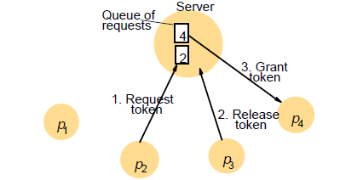

Slide 99
• Performance
– enter overhead: two messages (request and grant)
– enter delay: time between request and grant
– exit overhead: one message (release)
– exit delay: none
– synchronization delay: between release and grant
– centralized server is the bottleneck

Slide 100
A ring-based algorithm
• Arrange processes in a logical ring to rotate a token
– Wait for the token if it requires to enter the critical section
– The ring could be unrelated to the physical configuration
• p_{i} sends messages to p_{(i+1) mod N}
– when a process requires to enter the critical section, waits for the token
– when a process holds the token
• If it requires to enter the critical section, it can enter
– when a process releases a token (exit), it sends to its neighbor
• If it doesn’t, just immediately forwards the token to its neighbor

Slide 101
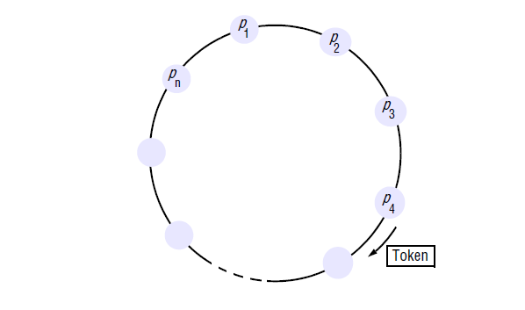

Slide 102
• Performance
– bandwidth consumption: token keeps circulating
– enter overhead: 0 to N messages
– enter delay: delay for 0 to N messages
– exit overhead: one message
– exit delay: none
– synchronization delay: delay for 1 to N messages

Slide 103
An algorithm using multicast and logical clocks
• Multicast a request message for the token (Ricart and Agrawala [1981])
– enter only if all the other processes reply
– totally-ordered timestamps: <T, pi >
• Each process keeps a state: RELEASED, HELD, WANTED
– if all have state = RELEASED, all reply, a process can hold the token and enter
– if a process has state = HELD, doesn't reply until it exits
– if more than one process has state = WANTED, process with the lowest timestamp will get all N-1 replies first

Slide 104
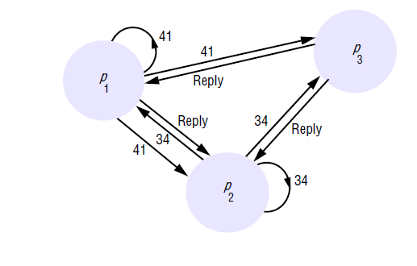

Slide 105
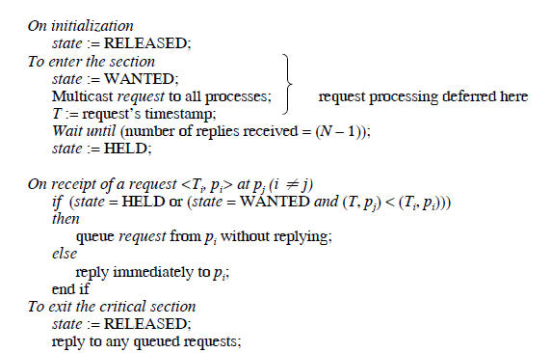

Slide 106
Elections
• Election: choosing a unique process for a particular role
– All the processes agree on the unique choice
• Assumptions
– Each process can call only one election at a time
– multiple concurrent elections can be called by different processes
– Participant: engages in an election
• each process pi has variable elected_{i} = ? (don't know) initially
• process with the largest identifier wins
– The (unique) identifier could be any useful value

Slide 107
A ring-based election algorithm
• Arrange processes in a logical ring
– pi sends messages to p(i+1) mod N
– It could be unrelated to the physical configuration
– Elect the coordinator with the largest id
– Assume no failures

Slide 108
Initially, every process is a non-participant. Any process can call an election
– Marks itself as participant
– Places its id in an election message
– Sends the message to its neighbor
– Receiving an election message
• if id > myid, forward the msg, mark participant
• if id < myid
– non-participant: replace id with myid: forward the msg, mark participant
– participant: stop forwarding (why? Later, multiple elections)
• if id = myid, coordinator found, mark non-participant, elected_{i} := id, send elected message with myid

Slide 109
message with myid
– Receiving an elected message
• id != myid, mark non-participant, elected_{i} := id forward the msg
• if id = myid, stop forwarding

Slide 110
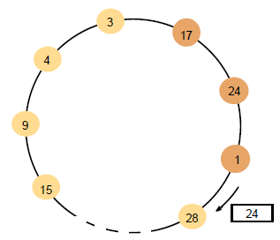

Slide 111
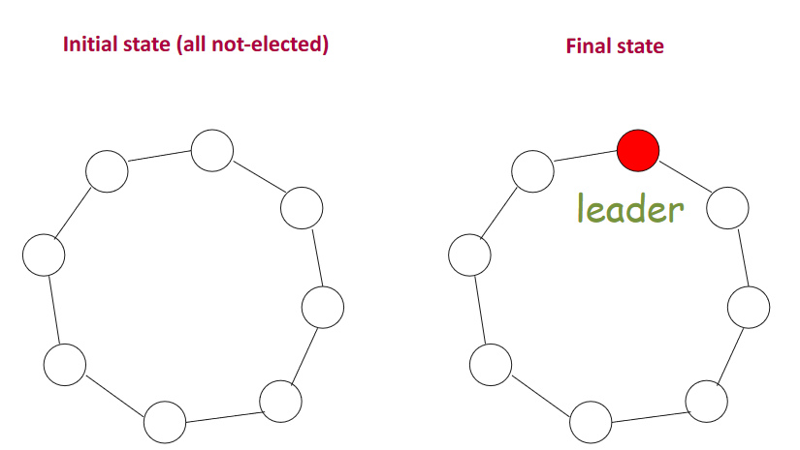
Leader election in a ring

Slide 112
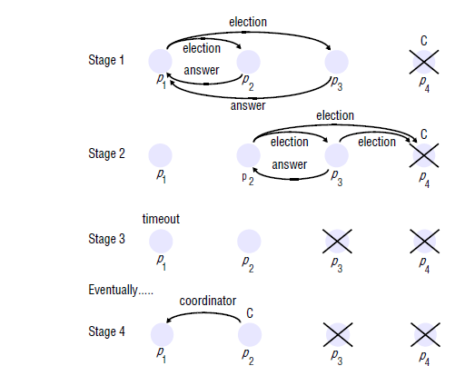
Bully Algorithm

Slide 113
Ricart & Agrawala’s algorithm
{Ricart & Agrawala’s algorithm}
ME1. Prove that at most one process can be in CS.
ME2. Prove that deadlock is not possible.
ME3. Prove that FIFO fairness holds even if
channels are not FIFO
Message complexity = 2(N-1)
(N-1 requests + N-1 acks - no release message)
TS(j) < TS(k)
Req(k)
Ack(j)
k
j
Req(j)

Slide 114
Maekawa’s algorithm
Close to” Ricart-Agrawala’s solution, but each process is required to obtain permission from only a subset of peers

Slide 115
Version 1 {Life of process I}
1. Send timestamped request to each process in S_{i}.
2. Request received → send ack to process with the lowest timestamp. Thereafter, "lock" (i.e. commit) yourself to that process, and keep others waiting.
3. Enter CS if you receive an ack from each member in S_{i}.
4. To exit CS, send release to every process in S_{i}.
5. Release received → unlock yourself. Then send ack to the next process with the lowest timestamp.
S₀ = {0, 1, 2}
S₁ = {1, 3, 5}
S₂ = {2, 4, 5}
S₃ = {0, 3, 4}
S₄ = {1, 4, 6}
S₅ = {0, 5, 6}
S₆ = {2, 3, 6}

Slide 116
Maekawa’s algorithm-version 1
ME1. At most one process can enter its critical section at any time.
Let i and j attempt to enter their Critical Sections
S_{i} ∩ S_{j} ≠ ∅ implies there is a process k ∊ S_{i} ⋂ S_{j}
Process k will never send ack to both.
So it will act as the arbitrator and establishes ME1

Slide 117
Maekawa’s algorithm-version 1
ME2. No deadlock. Unfortunately deadlock is possible! Assume 0, 1, 2 want to enter their critical sections.
From S₀= {0,1,2}, 0,2 send ack to 0, but 1 sends ack to 1;
From S₁= {1,3,5}, 1,3 send ack to 1, but 5 sends ack to 2;
From S₂= {2,4,5}, 4,5 send ack to 2, but 2 sends ack to 0;
Now, 0 waits for 1 (to send a release), 1 waits for 2 (to send a release), , and 2 waits for 0 (to send a release), . So deadlock is possible!

Slide 118
Maekawa’s algorithm-Version 2
Avoiding deadlock
If processes always receive messages in increasing order of timestamp, then deadlock “could be” avoided. But this is too strong an assumption.
Version 2 uses three additional messages:
- failed
- inquire
- relinquish
S₀ = {0, 1, 2}
S₁ = {1, 3, 5}
S₂ = {2, 4, 5}
S₃ = {0, 3, 4}
S₄ = {1, 4, 6}
S₅ = {0, 5, 6}
S₆ = {2, 3, 6}

Slide 119
New features in version 2
Send ack and set lock as usual.
If lock is set and a request with a larger timestamp arrives, send failed (you have no chance). If the incoming request has a lower timestamp, then send inquire (are you in CS?) to the locked process.
- Receive inquire and at least one failed message → send relinquish. The recipient resets the lock.

Slide 120
Deadlock can be avoided by using the following mechanism: when a processor makes a request, it assigns a (Lamport) timestamp to the request. The voters will prefer to vote for the earliest candidates. If a processor V has cast its ballot for processor B and then processor C, which has an earlier timestamp than B's, asks for V's vote, V will try to retrieve its vote from B with an INQUIRE message. If B has not yet received all the votes of its voting district, it will relinguish V's vote, which can then be given to C. Lamport timestamps impose a total order, so either the candidate with the lowest timestamp eventually gets all of the votes or the candidate with the lowest timestamp is blocked by a candidate that enters the critical section. In either case, some candidate enters the critical section, so deadlock is avoided.

